Slide 1


Introduction to Machine Learning in TensorFlow
Fondren Library
Digital Scholarship Services

Slide 2
ABOUT TENSORFLOW
Created by Google in 2015
Wide industry use, especially within Google
Optimized methods for extremely fast computation
Great for research as well!
Very low-level
i.e. not user-friendly, but extremely powerful

Slide 3
ABOUT KERAS
Very user-friendly
A bit of a trade-off in achievable performance (usually worth it!)
Intuitive interface on top of TensorFlow

Slide 4
TENSORFLOW AND KERAS
TensorFlow handles the work behind the scenes
Although it doesn’t have to! Other frameworks (Theano, etc) exist
Keras makes it easy and intuitive to build a complex model without manually specifying each operation
This combination makes TensorFlow + Keras easy to use and extremely fast!

Slide 5
WHAT IS MACHINE LEARNING?
Regression, Classification, Artificial Intelligence, Reinforcement Learning

Slide 6
THREE KINDS OF MACHINE LEARNING
Machine Learning is an umbrella term
As a new field, there are a lot of discussions
Electrical Engineering?
Computer Science?
Data Science?
Maybe information theory?
A combination?

Slide 7
REGRESSION
Modeling problem wherein we want to predict a continuous value
i.e. the value can take a large range, not just a few
Example: Predicting university acceptance rates from number of books in the school’s library

Slide 8
CLASSIFICATION
Modeling problem wherein we want to predict a membership
i.e. there are a limited number of groups and we want to know which one to assign this example to
Example: Predicting whether an image is of a cat or a dog

Slide 9
REINFORCEMENT LEARNING
Modeling problem wherein we have sequential, continuous input and feedback from the model interacting with the environment
Example: Trying to get out of a maze, and changing our algorithm based on how long it took to get out (maybe by switching from random choice to always turning left)

Slide 10
ARTIFICIAL INTELLIGENCE
A very vague phrase with tons of possible meanings
Modeling technique wherein we use artificial neural networks to produce more in-depth results
Example: Predicting whether an image is of a cat or a dog using neural networks

Slide 11
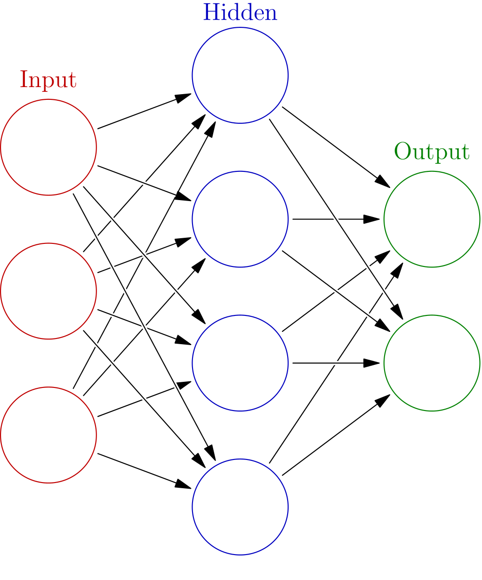
NEURAL NETWORKS
Basically, a system of connections
Analogy to the brain (neuron)
Figuring out how much one neuron impacts others
Traditionally, this is framed as a sequence of ‘layers’ with connections between layers, although this is changing

Slide 12
LINEAR REGRESSION
Simple Modeling

Slide 13
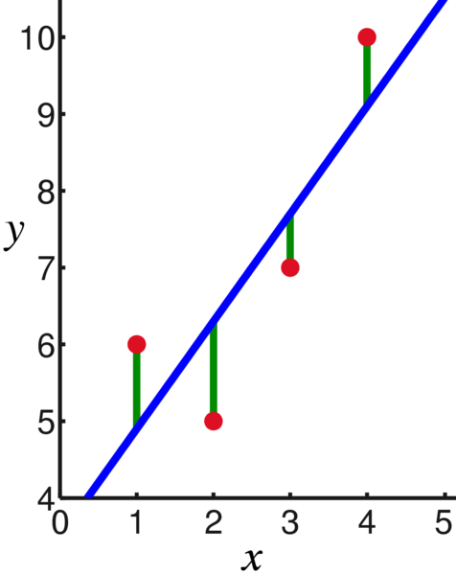
BASIC LINEAR REGRESSION
Commonly referred to as ‘line of best fit’, ‘trend line,’ and similar things
Basic idea: minimizing the squared prediction error

Slide 14
WHY LINEAR REGRESSION?
There’s a tendency among people new to machine learning to immediately jump to deep neural networks when they don’t need to
Simple model, easy to interpret, extremely fast!
Often, the most appropriate method
Occam’s razor

Slide 15
LOGISTIC REGRESSION
Not regression at all! Simple classification

Slide 16
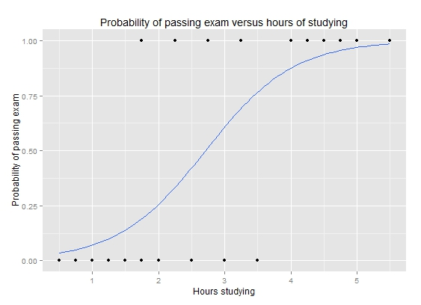
BASIC LOGISTIC REGRESSION
Not regression!
Sadly, a lot of terms are confusing in machine learning
Basic idea: predict the probability that each sample belongs to a class (consistency is key!) and minimize the difference between predicted probability and actual membership
e.g. if we predict a picture is of a cat with 95% probability and it isn’t, that’s a pretty big penalty, but predicting 51% cat is significantly less

Slide 17
WHY LOGISTIC REGRESSION?
There’s a tendency among people new to machine learning to immediately jump to deep neural networks when they don’t need to
Simple model, easy to interpret, extremely fast!
And, it can outperform neural networks on a wide range of problems in a fraction of the time!

Slide 18
NEURAL NETWORKS
More flexible, more costly to train and use

Slide 19
WHY NEURAL NETWORKS?
Extraordinarily flexible
Can capture relationships linear and logistic regression are unable to
Decide the tradeoffs are worth it
Time
Computing power
Interpretability

Slide 20
HOW DO NEURAL NETS WORK?
Forward and backward
Forward:
Each layer ‘feeds forward’ to the next
This continues until we hit ‘output’
Backward:
Updating based on our results
If we’re really off base, change.
If not, don’t.

Slide 21
NEURAL NETWORK PHASES
Training:
Give the neural net labelled data
Allow it to update based on mistakes
Validation:
An intermediate step
A hold-out test set of unseen examples, just to get a baseline reading, and see how training is going (diagnostic)
Testing:
After we’re completely done training & validating, see how well it generalizes to a completely unseen set, and evaluate our final performance!

Slide 22
WHAT CAN A NEURAL NET DO?
Neural nets work so well because they can ‘form their own conclusions’
The net adaptively changes when confronted with new information
Often, neural nets will seem to figure out what is important during the training process, although this is at its core just fairly simple optimization
No magic!

Slide 23
WHAT ARE THE DRAWBACKS?
Just because a net can get a perfect result doesn’t mean it will!
Success is not guaranteed! Small changes in training data can lead to wildly different results
It’s hard to tell what’s really going on!
Interpretability issues
Can we trust the conclusions of a neural net? Should we?

Slide 24
NEURAL NETWORKS & CONVOLUTION
Leveraging spatial information in neural nets

Slide 25
WHY CONVOLUTION & NEURAL NETS?
Upgrade to neural nets for a significant class of problems
Spatial data matters! It doesn’t make sense to ‘flatten’ an image to a row of pixels, because then you’re losing vertical and diagonal relationships
Solution: find a way to extract features!
What matters in a 3x3 square, for example?
We don’t have to figure this out ourselves!
Neural nets will do this during training

Slide 26
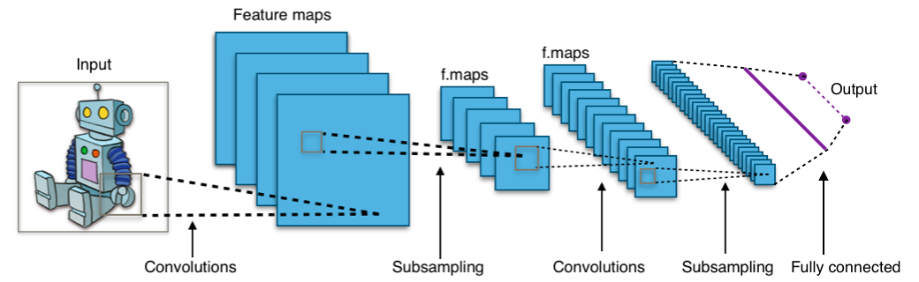
SAMPLE CNN ARCHITECTURE

Slide 27
INTERPRETING LAYERS
Subsampling
Condensing information, zooming in/out
Convolutions
Extracting features

Slide 28
ARTIFICIAL INTELLIGENCE
How intelligent is it?

Slide 29
PERCEPTRONS
Similar to logistic regression, but sequential updates
Responding to the environment!
Idea: come in with a hypothesis of how to divide two classes
Perform updates until we can divide them fully (or give up)
This can be seen as a single neuron in a neural net

Slide 30
NEURAL NETS AND AI
We can do the same thing we’ve done with other problems
Throw neural nets at them and see what happens!
Neural nets are incredibly good in the context of AI
Recently, for the first time in the game of Go, a computer beat the highest-ranked human player (Google’s AlphaGo)
This happened in chess in 1997
Only possible due to amazing advancements in artificial intelligence!

Slide 31
FURTHER DIRECTIONS
An overview of current research topics

Slide 32
TEXT-BASED MODELS
Predicting part-of-speech, emotional orientation (happy? sad? angry?)
Neural nets are great for dealing with longer term relationships
If we have an antecedent 10 words back, it’s very hard for conventional models to even detect this has happened, much less deal with it constructively, without absurd increases in complexity
We can even find ways to represent words algebraically!
Queen = King – Man
This process is called ‘word embeddings’

Slide 33
VIDEO MODELS
We’ve seen image models, but what do we do with continuous input?
Sequential information in conjunction with spatial relationships
Speed extremely important!
We can get 60 images a second
Security cameras can detect threats without constant human surveillance
And, if you’ve seen movies… humans aren’t always the most reliable when it comes to watching security feeds

Slide 34
INTERPRETABILITY
Adversarial learning
Deliberately give the net the worst possible inputs while training or testing to ‘sabotage’ it
We can learn how to train very robust models!
Making small changes and seeing how that affects the predictions
Does adding a little red smudge in an image make a cat into a dog?

Slide 35
RECAP
Don’t just jump into neural networks!
Try simpler things out
Extraordinarily flexible
Often can outperform humans at complex tasks!
Chess, Go, etc
Despite some significant drawbacks, neural networks are one of the most exciting developments of the 21st century and can be applied to an amazing variety of problems

Slide 36
ACKNOWLEDGMENTS
TensorFlow, the TensorFlow logo, and any related marks are trademarks of Google Inc.
The diagram of a neural network on the Neural Networks slide is used under the terms of CC-BY-SA 3.0 license.
CNN Architeture is by Aphex34 - Own work, CC BY-SA 4.0, https://commons.wikimedia.org/w/index.php?curid=45679374
The logistic regression figure, made by Michaelg2015, is licensed under the Creative Commons Attribution-Share Alike 4.0 International license.

